Slide 1
Scenario
After search motor route by Wi-Fi at home. Mr. Khuong start his trip.

Slide 2
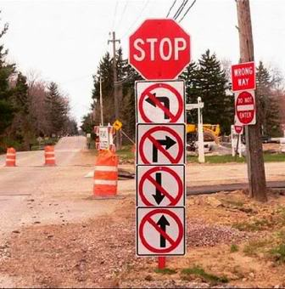
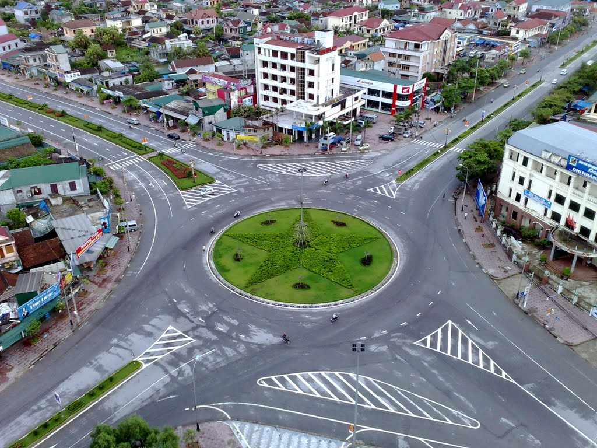
Problem
Mr. Khuong doesn’t know what he should do, when he is driving. Mr. Khuong doesn’t know where he should turn, when he meets corner.
And he doesn’t has 3G to view map.

Slide 3
Solution
Provide application has:
- Offline map, don’t need 3G to view map.
- Auto detect and notify at each motorbike turn.

Slide 4
Distance from point to segment algorithm

Slide 5
A
B

Slide 6
C
A
B

Slide 7
C
A
B

Slide 8
C
d
A
B

Slide 9
A
B
C

Slide 10
A
B
C

Slide 11
A
B
C

Slide 12
A
B
d
C

Slide 13
Notify detect algorithm

Slide 14
E
A
C
D
B

Slide 15
E
A
C
D
B

Slide 16

E
A
C
D
B

Slide 17
E
A
C
D
B

Slide 18
E
A
C
D
B

Slide 19
E
A
C
D
B

Slide 20
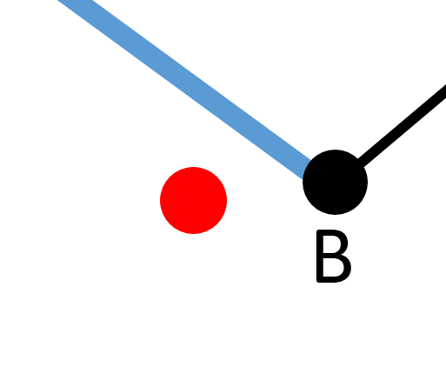
E
A
C
D
B

Slide 21
E
A
C
D
B

Slide 22
E
A
C
D
B

Slide 23
Notify: prepare to turn left
E
A
C
D
B

Slide 24
E
A
C
D
B

Slide 25
Notify: prepare to turn right
E
A
C
D
B

